Slide 1

Movie Review Sentiment Analysis
Imran
Mobile Computing Lab

Slide 2
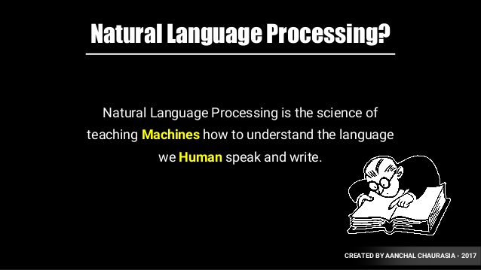

Slide 3
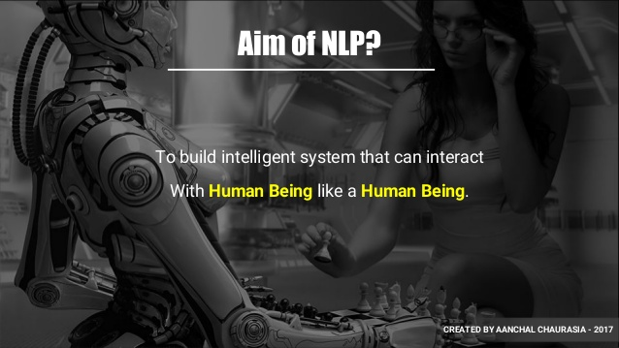

Slide 4
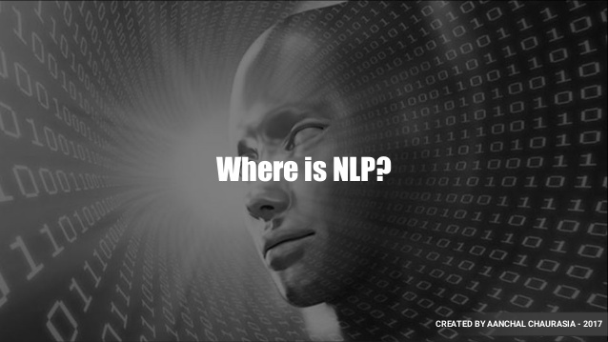

Slide 5
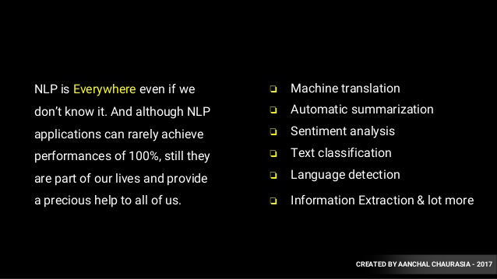

Slide 6
Sentiment Analysis
What is Sentiment Analysis?

Slide 7


Positive or negative movie review?
unbelievably disappointing
Full of zany characters and richly applied satire, and some great plot twists
this is the greatest screwball comedy ever filmed
It was pathetic. The worst part about it was the boxing scenes.

Slide 8
Google Product Search
a

Slide 9
Sentiment analysis has many other names
Opinion extraction
Opinion mining
Sentiment mining
Subjectivity analysis

Slide 10
Why sentiment analysis?
Movie: is this review positive or negative?
Products: what do people think about the new iPhone?
Public sentiment: how is consumer confidence? Is despair increasing?
Politics: what do people think about this candidate or issue?
Prediction: predict election outcomes or market trends from sentiment

Slide 11
Scherer Typology of Affective States
Emotion: brief organically synchronized … evaluation of a major event
angry, sad, joyful, fearful, ashamed, proud, elated
Mood: diffuse non-caused low-intensity long-duration change in subjective feeling
cheerful, gloomy, irritable, listless, depressed, buoyant
Interpersonal stances: affective stance toward another person in a specific interaction
friendly, flirtatious, distant, cold, warm, supportive, contemptuous
Attitudes: enduring, affectively colored beliefs, dispositions towards objects or persons
liking, loving, hating, valuing, desiring
Personality traits: stable personality dispositions and typical behavior tendencies
nervous, anxious, reckless, morose, hostile, jealous

Slide 12
Sentiment Analysis
Simplest task:
Is the attitude of this text positive or negative?
More complex:
Rank the attitude of this text from 1 to 5
Advanced:
Detect the target, source, or complex attitude types

Slide 13
IMDB data in the Pang and Lee database
✓
✗
when _star wars_ came out some twenty years ago , the image of traveling throughout the stars has become a commonplace image . […]
when han solo goes light speed , the stars change to bright lines , going towards the viewer in lines that converge at an invisible point .
cool .
_october sky_ offers a much simpler image–that of a single white dot , traveling horizontally across the night sky . [. . . ]
“ snake eyes ” is the most aggravating kind of movie : the kind that shows so much potential then becomes unbelievably disappointing .
it’s not just because this is a brian depalma film , and since he’s a great director and one who’s films are always greeted with at least some fanfare .
and it’s not even because this was a film starring nicolas cage and since he gives a brauvara performance , this film is hardly worth his talents .

Slide 14
Dataset
Train Dataset
Features:
(PhraseId, SentenceId, Phrase, Sentiment)
Total instance of the features :(156060, 4)
Test Dataset
Features:
(PhraseId, SentenceId, Phrase)
Total instance of the features :(66292, 4)

Slide 15
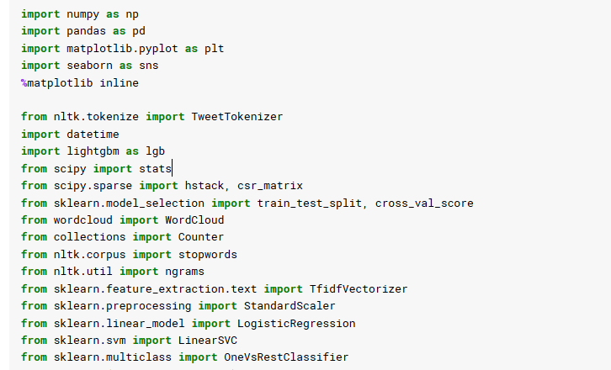
Importing necessary libraries

Slide 16

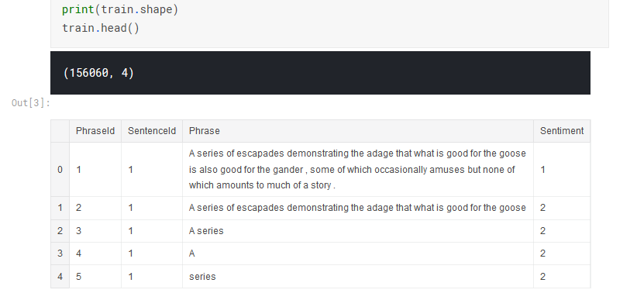
Importing and viewing dataset

Slide 17
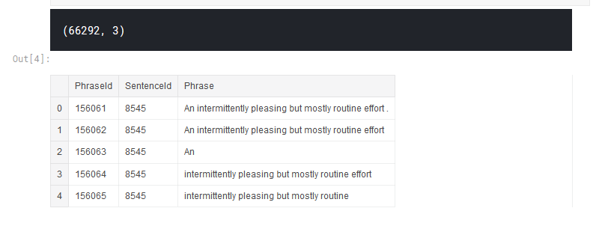
Importing and viewing dataset
Test.shape

Slide 18
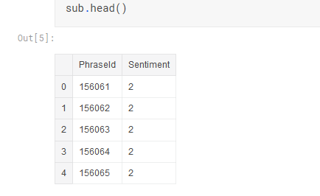
Importing and viewing dataset

Slide 19
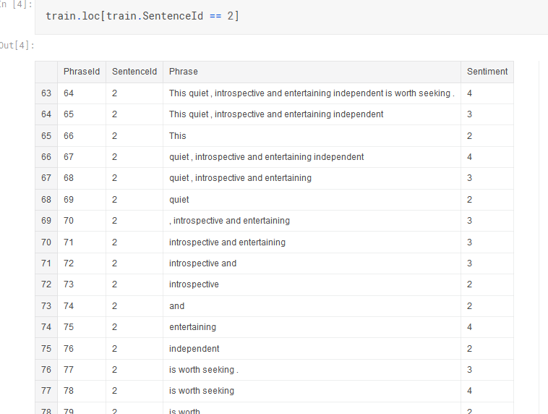
Filtering rows by a column value

Slide 20
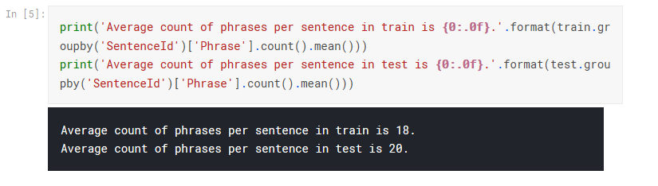
Average count of phrases per sentence in dataset
What is a phrase?
Words can be grouped together, but without a subject or a verb.
e.g. “After dinner”
“Waiting for the rain to stop”.
Notes:
What is a phrase?
Words can be grouped together, but without a subject or a verb. This is called a phrase.
Because a phrase has neither subject nor verb, it can’t form a ‘predicate’. This is a structure that must contain a verb, and it tells you something about what the subject is doing.
Phrases can be very short – or quite long. Two examples of phrases are:

Slide 21
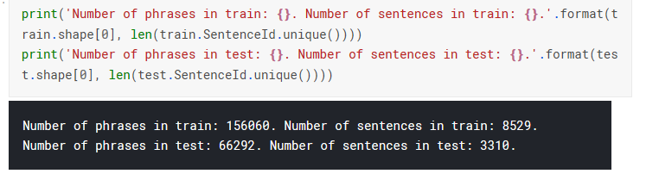
Number of phrases in the dataset

Slide 22
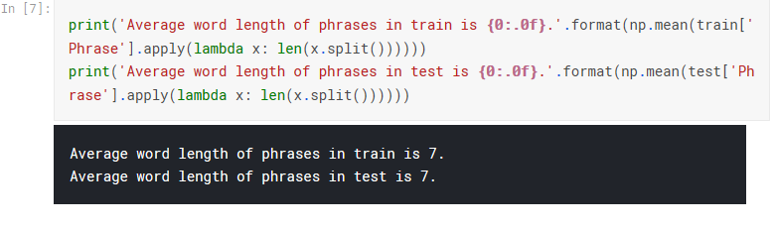
Average word length of phrases in the dataaset

Slide 23

N-Grams
Example:
What word is most likely to follow: I’d like to make a collect call
probabilistic models called N-grams to predict the next word from the previous n-1 words.
Computing the probability of the next word is related to computing the probability of a sequence of words.
Has a non-zero probability of appearing in a text
The same words in a different order have a very low probability
23

Slide 24
Word Prediction
N-grams are token sequences of length N.
i.e. I notice three guys standing on the
2-grams
(I notice), (notice three), (three guys), (guys standing), (standing on), (on the)
Given knowledge of counts of N-grams such as these, we can guess likely next words in a sequence.
we can use knowledge of the counts of N- grams to assess the conditional probability of candidate words as the next word in a sequence.
Or, we can use them to assess the probability of an entire sequence of words.

Slide 25
Applications
It turns out that being able to predict the next word (or any linguistic unit) in a sequence is an extremely useful thing to be able to do.
It lies at the core of the following applications
Automatic speech recognition
Handwriting and character recognition
Spelling correction
Machine translation
And many more.
25

Slide 26

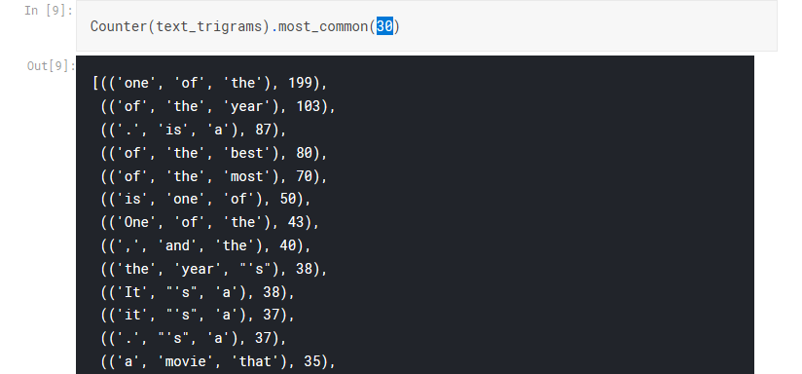
Let's see for example most common trigrams for positive phrases

Slide 27
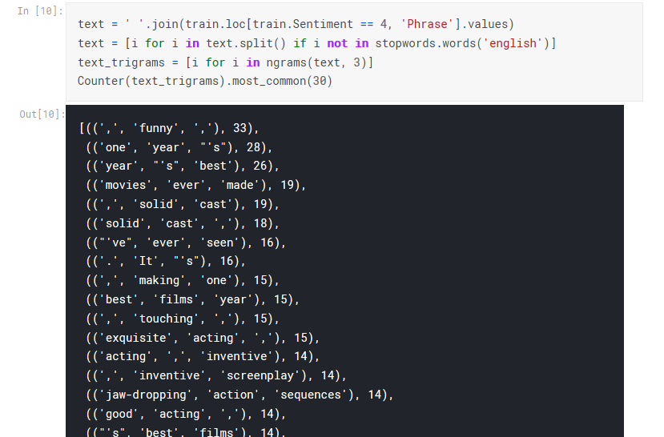
Let's see for example most common trigrams for positive phrases
Notes:
The results show the main problem with this dataset: there are to many common words due to sentenced splitted in phrases. As a result stopwords shouldn't be removed from text.

Slide 28
Thoughts on feature processing and engineering¶
So, we have only phrases as data. And a phrase can contain a single word. And one punctuation mark can cause phrase to receive a different sentiment. Also assigned sentiments can be strange. This means several things:
using stop words can be a bad idea, especially when phrases contain one single stop word;
punctuation could be important, so it should be used;
N grams are necessary to get the most info from data;
using features like word count or sentence length won't be useful;
Notes:
The results show the main problem with this dataset: there are to many common words due to sentenced partitioned into phrases. As a result stop words shouldn't be removed from text.

Slide 29
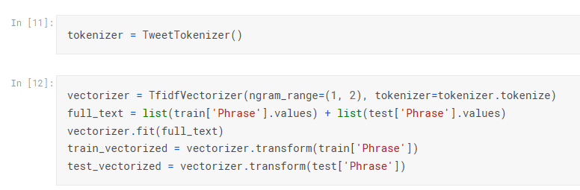
Converting both train and test set to vector

Slide 30
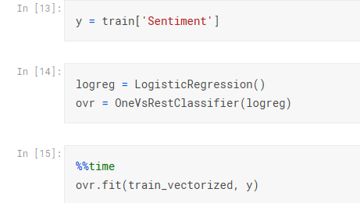
Splitting dataset and training logistic regression model

Slide 31
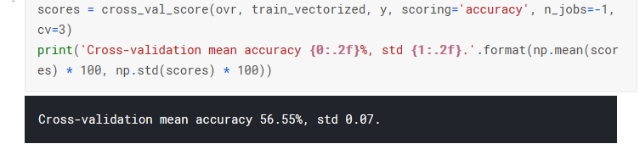
Cross validation of trained model

Slide 32
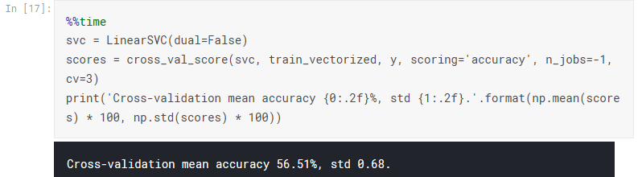
Training Linear Support Vector Classification.

Slide 33
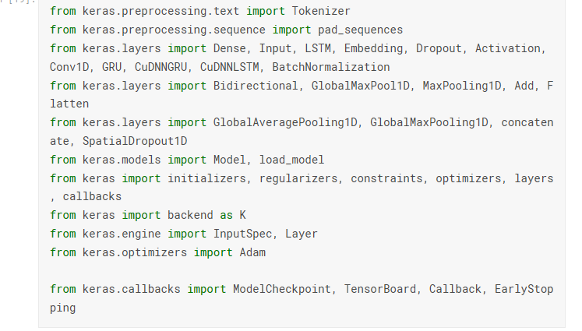
Training Deep learning based Model For Keras
Notes:
Keras is a user-friendly neural network library written in Python

Slide 34
Training Deep learning based Model For Keras
tk = Tokenizer(lower = True, filters='')
tk.fit_on_texts(full_text)
train_tokenized = tk.texts_to_sequences(train['Phrase'])
test_tokenized = tk.texts_to_sequences(test['Phrase'])
max_len = 50
X_train = pad_sequences(train_tokenized, maxlen = max_len)
X_test = pad_sequences(test_tokenized, maxlen = max_len)
from sklearn.preprocessing import OneHotEncoder
ohe = OneHotEncoder(sparse=False)
y_ohe = ohe.fit_transform(y.values.reshape(-1, 1))

Slide 35
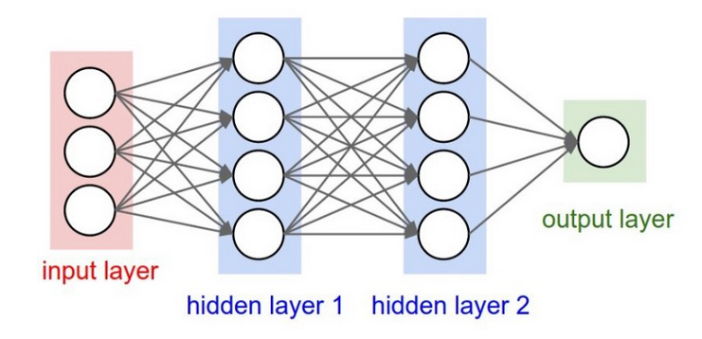
Training Deep learning based Model For Keras
x = BatchNormalization()(x)
x = Dropout(dr)(Dense(dense_units, activation='relu') (x))
x = BatchNormalization()(x) x = Dropout(dr)(Dense(
(dense_units / 2), activation='relu') (x))
x = Dense(5, activation = "sigmoid")(x)
model = Model(inputs = inp, outputs = x)
model.compile(loss = "binary_crossentropy", optimizer = Adam(lr = lr, decay = lr_d), metrics = ["accuracy"])
history = model.fit(X_train, y_ohe, batch_size = 128, epochs = 20, validation_split=0.1, verbose = 1, callbacks = [check_point, early_stop])
model = load_model(file_path)
For model 1
lr = 1e-3, lr_d = 1e-10, dense_units=32, dr=0.1
Notes:
Dropout:A Simple Way to Prevent Neural Networks from Overfitting
Batch normalization is a technique for training very deep neural networks that standardizes the inputs to a layer for each mini-batch. This has the effect of stabilizing the learning process and dramatically reducing the number of training epochs required to train deep networks.

Slide 36
Training Deep learning based Model For Keras
Accuracy : for 20 epochs using pre trained model best_model.hdf5 is 87.34
Notes:
units: Positive integer, dimensionality of the output space.

Slide 37
Resources and Kernels
https://www.kaggle.com/artgor/movie-review-sentiment-analysis-eda-and-models/notebook

